Slide 1
GROUP MEETING · MAY 27
AI for scientific computing
and the PNP–BV problem, revisited
Jake Weinstein
Forward PDE simulation & inverse kinetics for ORR selectivity

Slide 2
DEMO
Live demo
→ switch to the terminal

Slide 3
PREFACE
Preface on the PNP–BV solver

Slide 4
What I’ll cover
1 The problem — ORR selectivity
2 Prior work I’m building on
3 The model — PNP–BV
4 Why it’s hard numerically
5 How this solver cracks it
6 Verification — how we know it’s right
7 What’s next
◆
PNP–BV solver
4

Slide 5
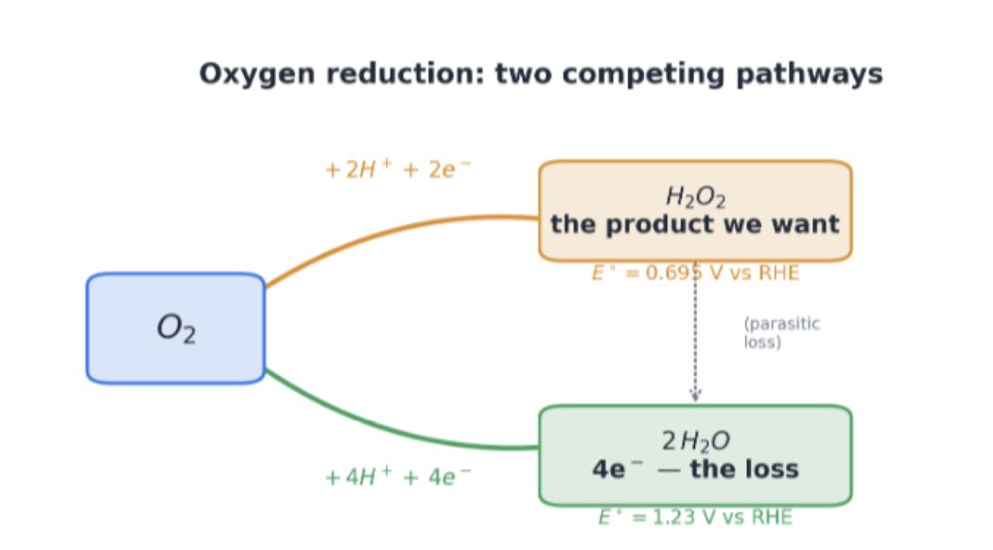
The problem: ORR selectivity
We want the 2e⁻ product (H₂O₂) — not the 4e⁻ loss all the way to water.
◆
PNP–BV solver
5

Slide 6
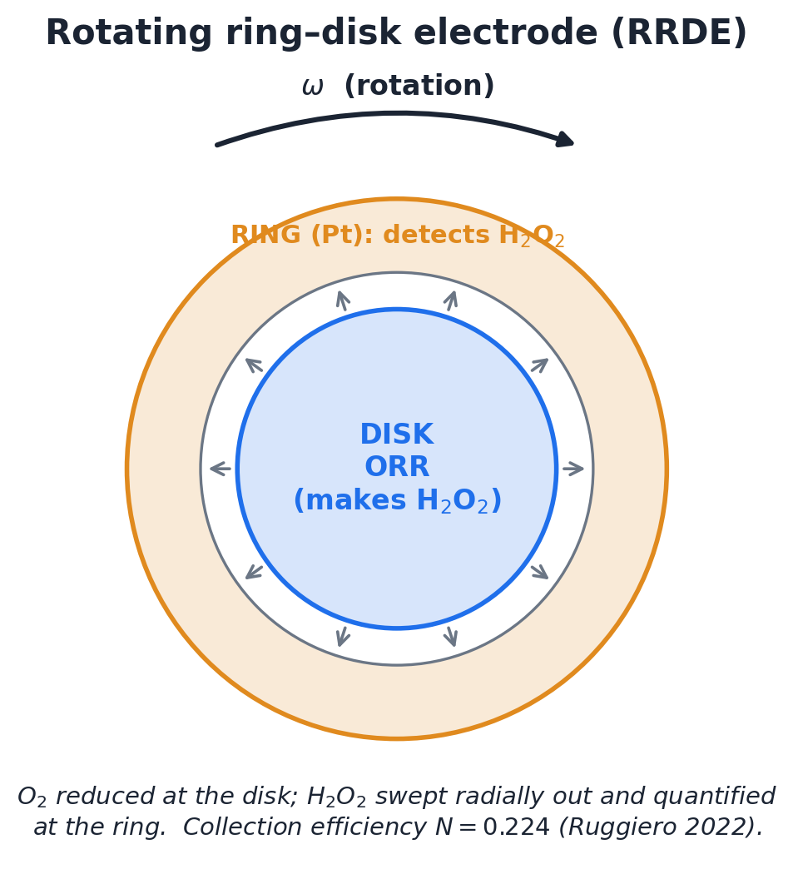
How it’s measured
Rotating ring-disk electrode: the disk makes H₂O₂, the ring downstream detects it.
◆
PNP–BV solver
6

Slide 7
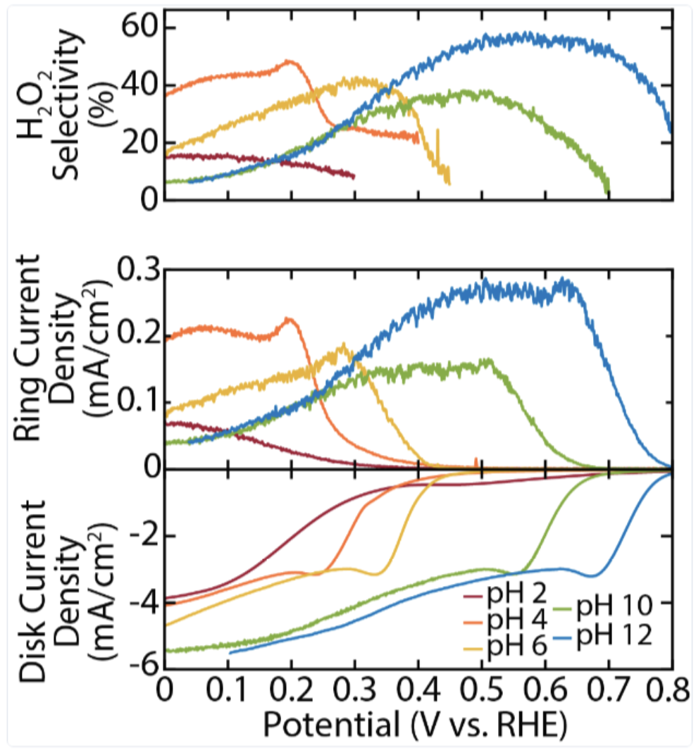
The data we’re trying to explain
Selectivity, ring & disk current vs potential, across pH (Seitz / Mangan deck).
◆
PNP–BV solver
7

Slide 8
The real goal
◆ Model selection — which mechanisms actually produce the curves?
◆ Parameter inference — recover the kinetics behind them
The forward solver is the engine; these two are the destination.
◆
PNP–BV solver
8

Slide 9
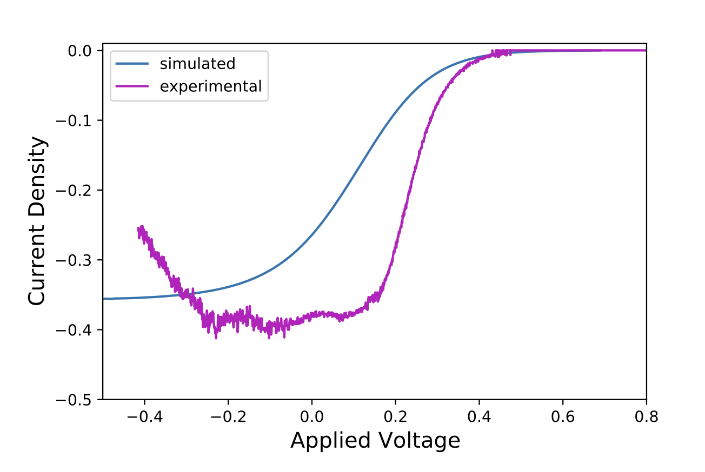
Previous work: Jithin George
◆ No spatial PDE solve
◆ Analytic closure for the concentrations, plus an ODE for the potential
◆ A boundary equation closes Butler–Volmer
Closure model vs experiment
◆
PNP–BV solver
9

Slide 10
Limitations of the closure approach
◆ One reaction only — can’t represent the 2e⁻ / 4e⁻ competition that is the selectivity
◆ A closure, not a transport solve — hard to add new physics (more ions, steric crowding, the Stern layer, surface coverage)
◆ No spatial fields — can’t probe local pH or double-layer structure at the interface
◆ Plateau & cliff look like artifacts of the closed form, not derived transport (per our own emulation)
◆
PNP–BV solver
10

Slide 11
THE SOLVER
Now to the full PDE solver

Slide 12
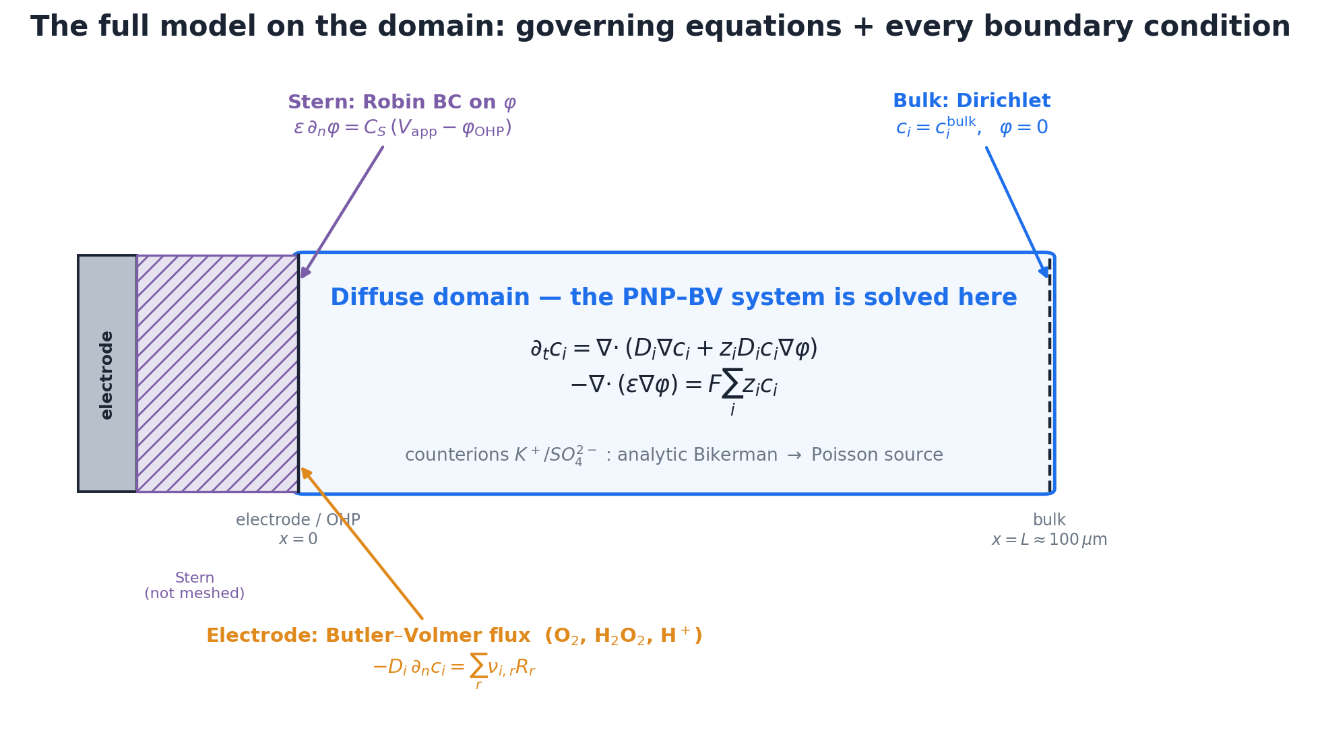
The model: PNP–BV
PNP in the diffuse layer · Butler–Volmer flux at the electrode · Stern Robin BC · analytic Bikerman counterions.
◆
PNP–BV solver
12

Slide 13
Why it’s numerically terrible
◆ Steady-state concentrations span ~10 orders of magnitude
◆ The potential varies sharply over a tiny region right at the electrode
◆ Exponential BV nonlinearity at the boundary → exponential concentration & potential buildup
◆ Electromigration and diffusion run on very different timescales
◆
PNP–BV solver
13

Slide 14
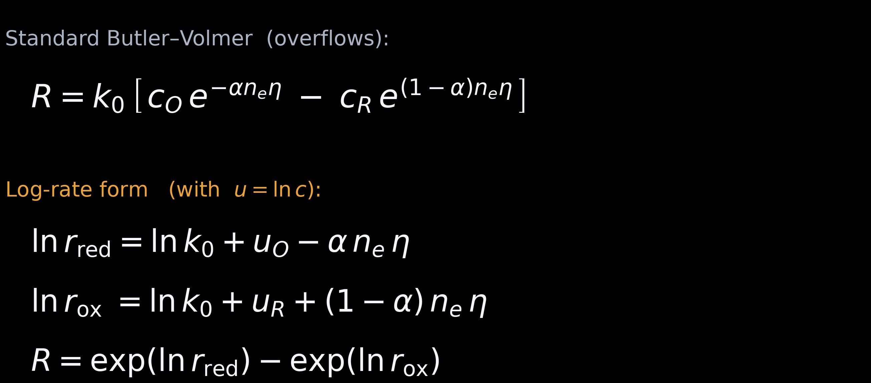
How we solve it
◆ Solve for u = ln c, not c — guarantees c > 0, tames the buildup
◆ For H⁺, solve for μ = u + φ — smooth across the double layer
◆ Log-rate Butler–Volmer — build the rate in log-space, exponentiate once →
◆ Analytic non-reactive ions — fewer fields to solve
◆ Continuation — never solve the hard problem cold
◆
PNP–BV solver
14

Slide 15
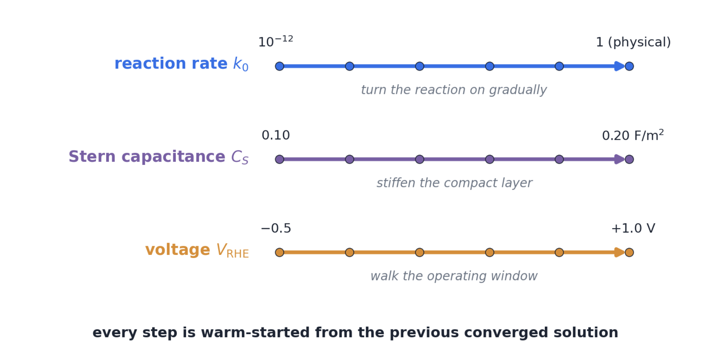
Continuation
Deform an easy problem into the hard one along three knobs — warm-start every step.
◆
PNP–BV solver
15

Slide 16
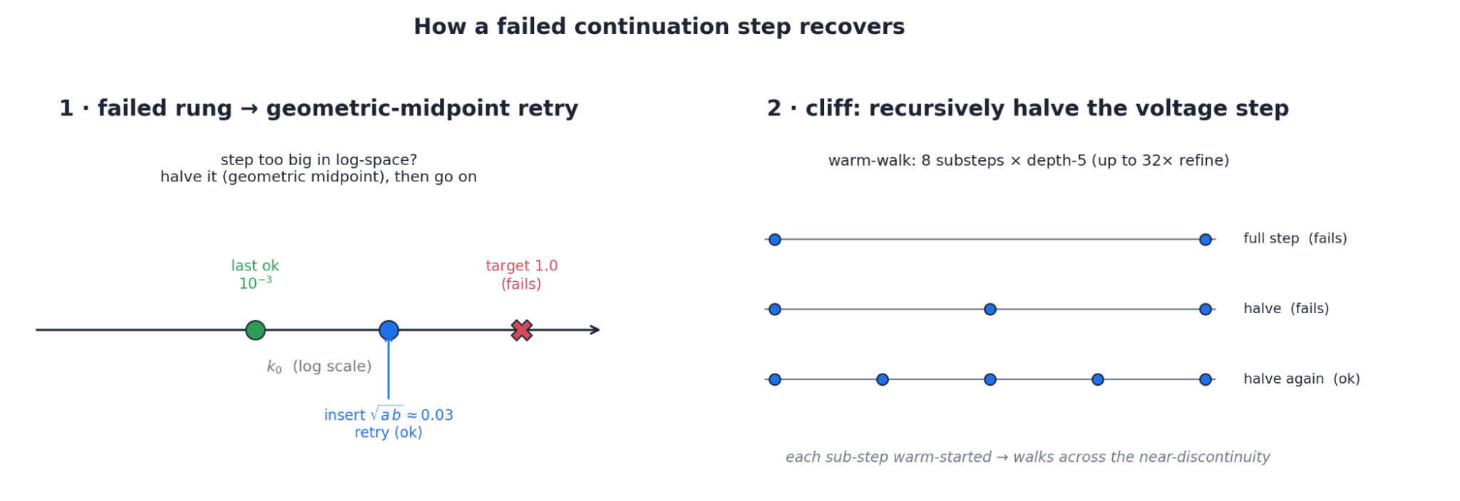
When a step fails: recover, don’t restart
√-midpoint retry for a failed rung; recursive bisection to walk across the Frumkin cliff.
◆
PNP–BV solver
16

Slide 17
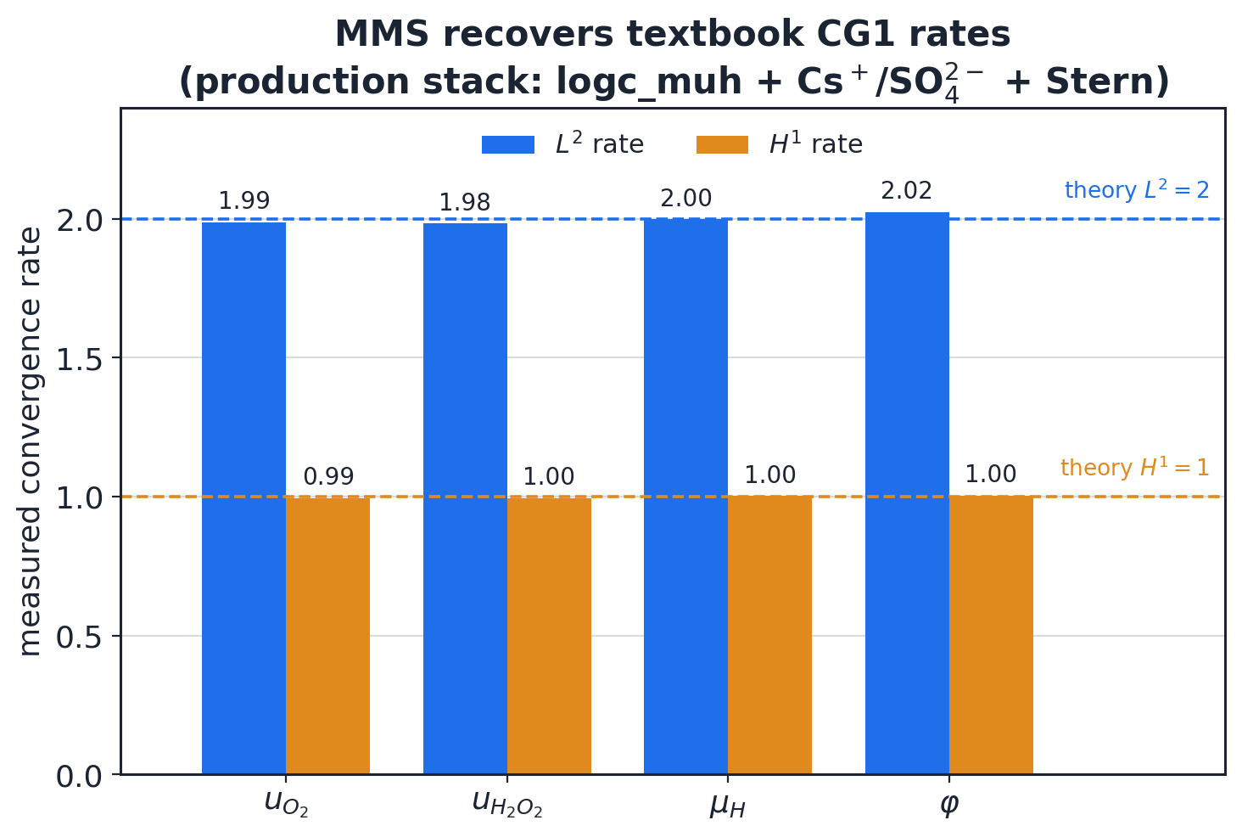
Verification — manufactured solutions
Observed convergence rates match CG1 theory (L²≈2, H¹≈1) for every field.
◆
PNP–BV solver
17

Slide 18
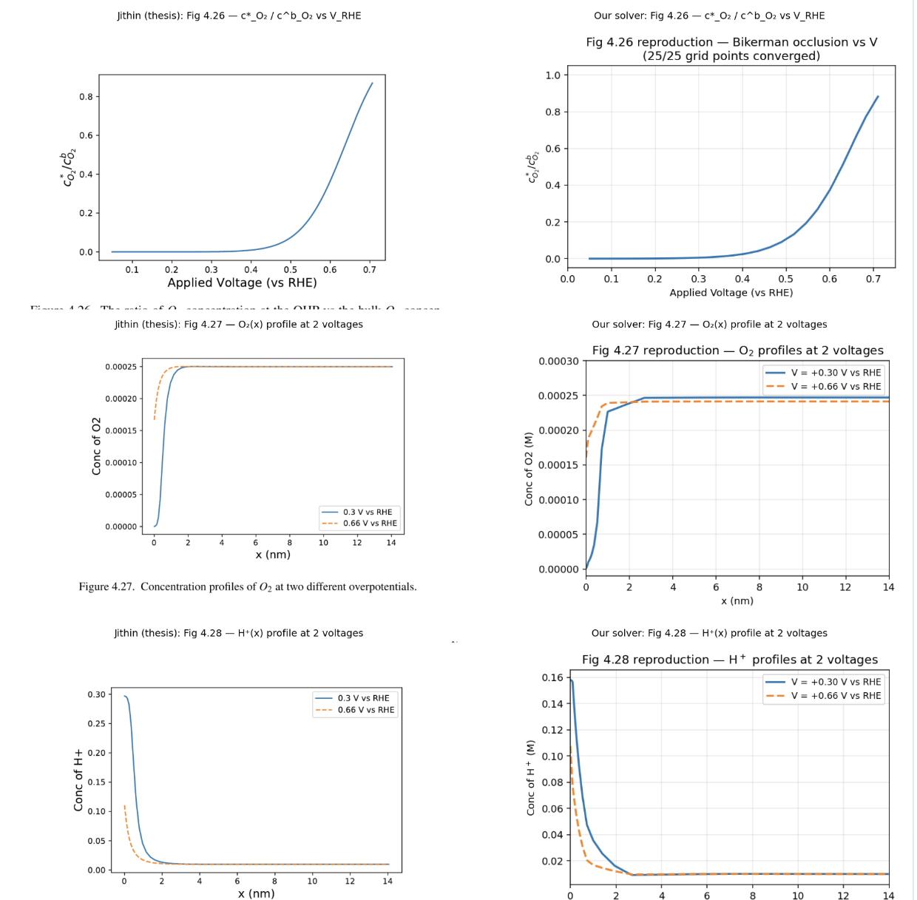
Verification — agreement with prior work
◆ Single 2e⁻ reaction — match the closure’s scope
◆ Shift V_RHE and E° by −0.785 V to align the OCP convention
◆ Match the closure’s transport & steric setup
◆ Reconstruct c_H⁺ from μ for the profiles
◆ Result: 25/25 converge; O₂-ratio & profiles within ~5%
◆
PNP–BV solver
18

Slide 19
What’s next?
◆ Use the solver as an experimental engine — search for the model that explains the curves
◆ Candidate physics: cation hydrolysis, local-pH coupling, surface coverage
◆ Then the inverse problem — infer the kinetics directly from data
◆
PNP–BV solver
19

Slide 20
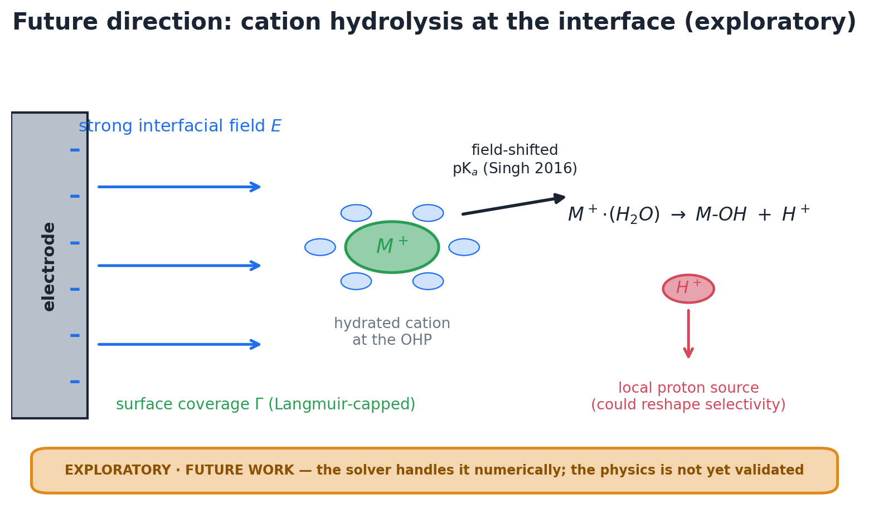
Tentative: cation hydrolysis
Field-shifted pKₐ (Singh 2016) turns the cation into a local proton source — reachable by the general solver, not the closure.
◆
PNP–BV solver
20

